Slide 1
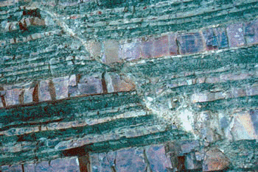
Shear fault usually not vertical
Fault slip creates earthquake
Fault slip
Big fault creates big earthquake

