Slide 1
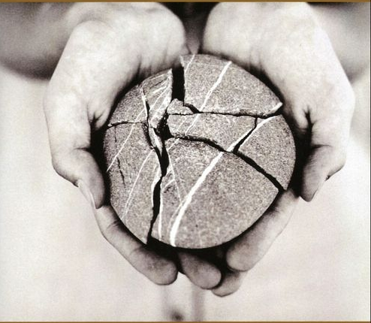
The Wisdom of Tenderness, also by Brennan Manning.
http://www.harpercollins.com/browseinside/index.aspx?isbn13=9780060724467

