Slide 1
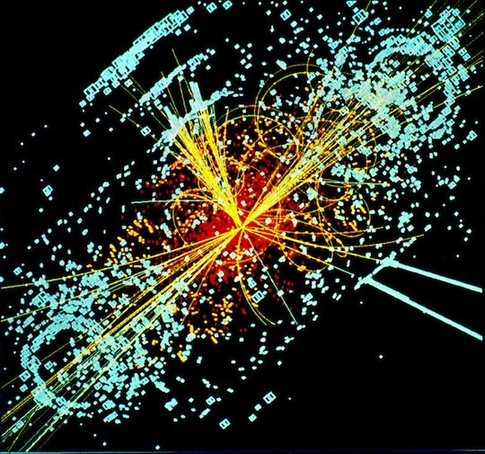
Read
Courtesy Parallel Universes, Time Travel & The God Particle! (LIST)
Posted 5 July 2012 by Garvey Ashhurst for Global Grind Staff.
Read more: http://globalgrind.com/news/what-are-god-particle-found-discovered-2012-time-travel-creationism-parallel-universes-list#ixzz1zn8GEjYU

